Slide 1
GIT /GITHUB
BY OSS CLUB AIT

Slide 2
INSTALLATION PROCESS
For windows (git bash) -
https://git-scm.com/downloads
For Ubuntu -
$sudo apt-get install git
Sign Up on www.github.com

Slide 3
Problems In Real Life
01
02
03
04
05
Code Sharing
Traceability
Merging Code
It provides you a platform to share code with your friends
Tracing when and where code is changed and by whom
Allows multiple developers to integrate their code
Reverting Back
Proper Testing
Going back to previous checkpoints
There are various options in github to test your code

Slide 4
Demo Of Problem
Let's see the Problem
And find its solution

Slide 5
Solutions in mind!
A Managing Software where we can save our checkpoints
An Online hosted service where we can collaborate with our friends

Slide 6
01
What is VCS ?
It stands for Version Control System
Version control, also known as source control, is the practice of tracking and managing changes to software code. Version control systems are software tools that help software teams manage changes to source code over time.
Example : git , subversion system, Apache Subversion etc.

Slide 7
What is GIT ?
Git is a free and open source distributed version control system designed to handle everything from small to very large projects with speed and efficiency

Slide 8
Why do we need GIT?
?
Work on new code without hampering previous code
To maintain code or logs
Collaborate with other coders

Slide 9
Git tracks the changes you make to files, so you have a record of what has been done, and you can revert to specific versions should you ever need to. Git also makes collaboration easier, allowing changes by multiple people to all be merged into one source. Work on new code without hampering previous code

Slide 10
Let's Install GIT
For Ubuntu-
For windows (git bash)-
https://git-scm.com/downloads
$sudo apt-get install git
Sign Up on www.github.com

Slide 11
First Time Setup
$ git config –global user.name "USERNAME"
$ git config –global user.email"USERNAME@gmail.com"
$ git config –global list

Slide 12
Doubts

Slide 13
How can we share our code or collaborate with our friends?
Initialize a new project/repository
Step 2
Step 4
Collaborating
Set up your Team
Make Branches,
Submitting pull request,
Merging pull request
Step 1
Step 3

Slide 14
What is GITHUB?
GitHub is a web-based interface that uses Git, the open source version control software that lets multiple people make separate changes to web pages at the same time
#social_media_of_dev

Slide 15
GITHUB Demo

Slide 16
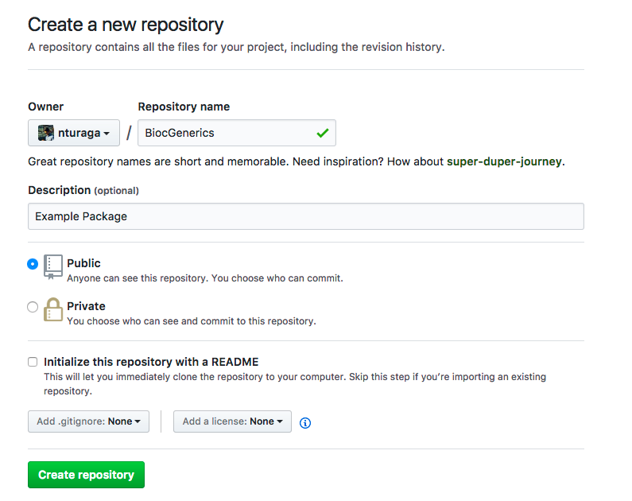
Creating Repository in GITHUB

Slide 17
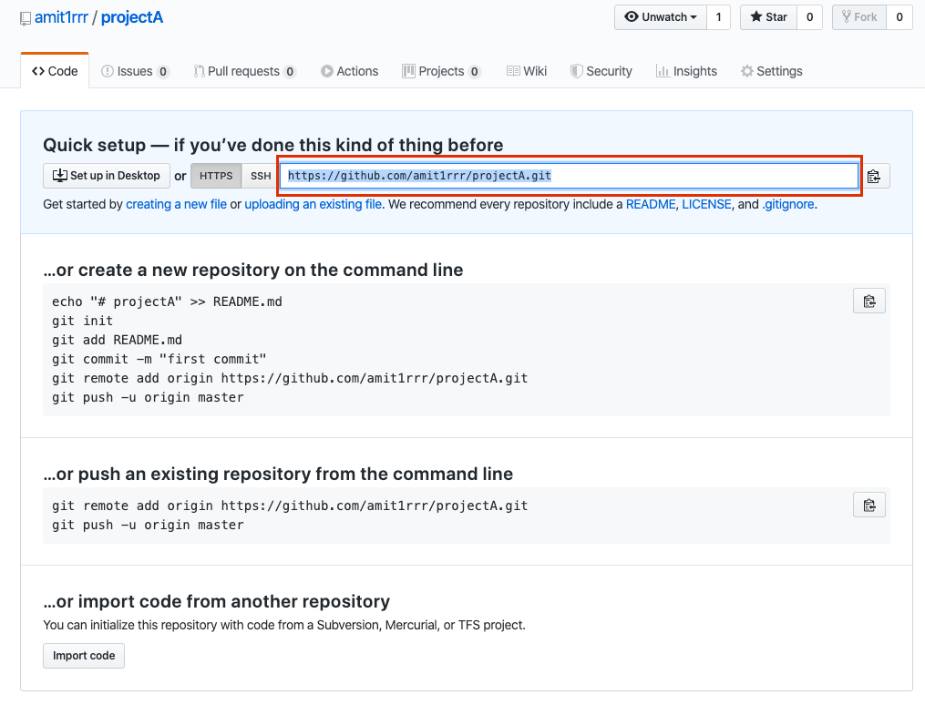
Adding files in Repo

Slide 18
Ready to work in collaboration
Person 1
Person 2
Easy way to share the data

Slide 19
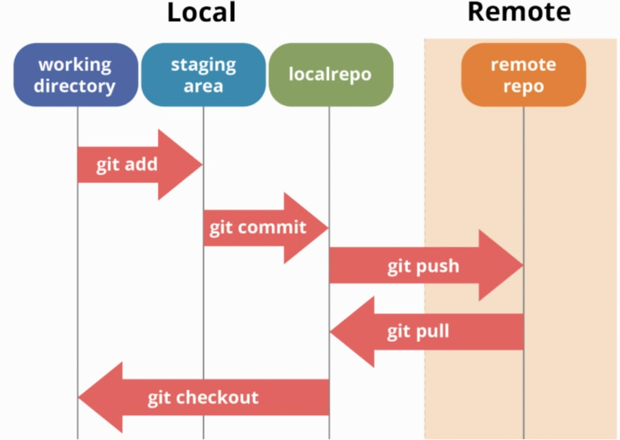
Workflow
The workflow is an automated procedure that you add to your repository. Workflows are made up of one or more jobs and can be scheduled or triggered by an event. The workflow can be used to build, test, package, release, or deploy a project on GitHub.

Slide 20
Doubts

Slide 21
What is difference between Git and GitHub?
GIT
GITHUB
Git is a software.
Git is a command-line tool
Git is installed locally on the system
Git is maintained by linux
Git is focused on version control and code sharing
GitHub is a service.
GitHub is a graphical user interface
GitHub is hosted on the web
Git is maintained by microsoft
GitHub is focused on centralized source code hosting

Slide 22
Github students developer pack
You can get ahead in your career and access the best developer tools used in the industry, for free, with the GitHub Student Developer Pack (the Pack). The Pack is open to every student 13 years or older in a degree-granting program, and we're committed to helping every student—no matter where you are

Slide 23
Doubts

Slide 24
THANK YOU
BY OSS CLUB AIT

